Slide 1

Unsupervised Learning using K-means Clustering: Python Vs ArcGIS
Cristian Noriega Monsalve, Blessing Austin-Gabriel, Ernest Chianumba, Rolih Ferdinand

Slide 2
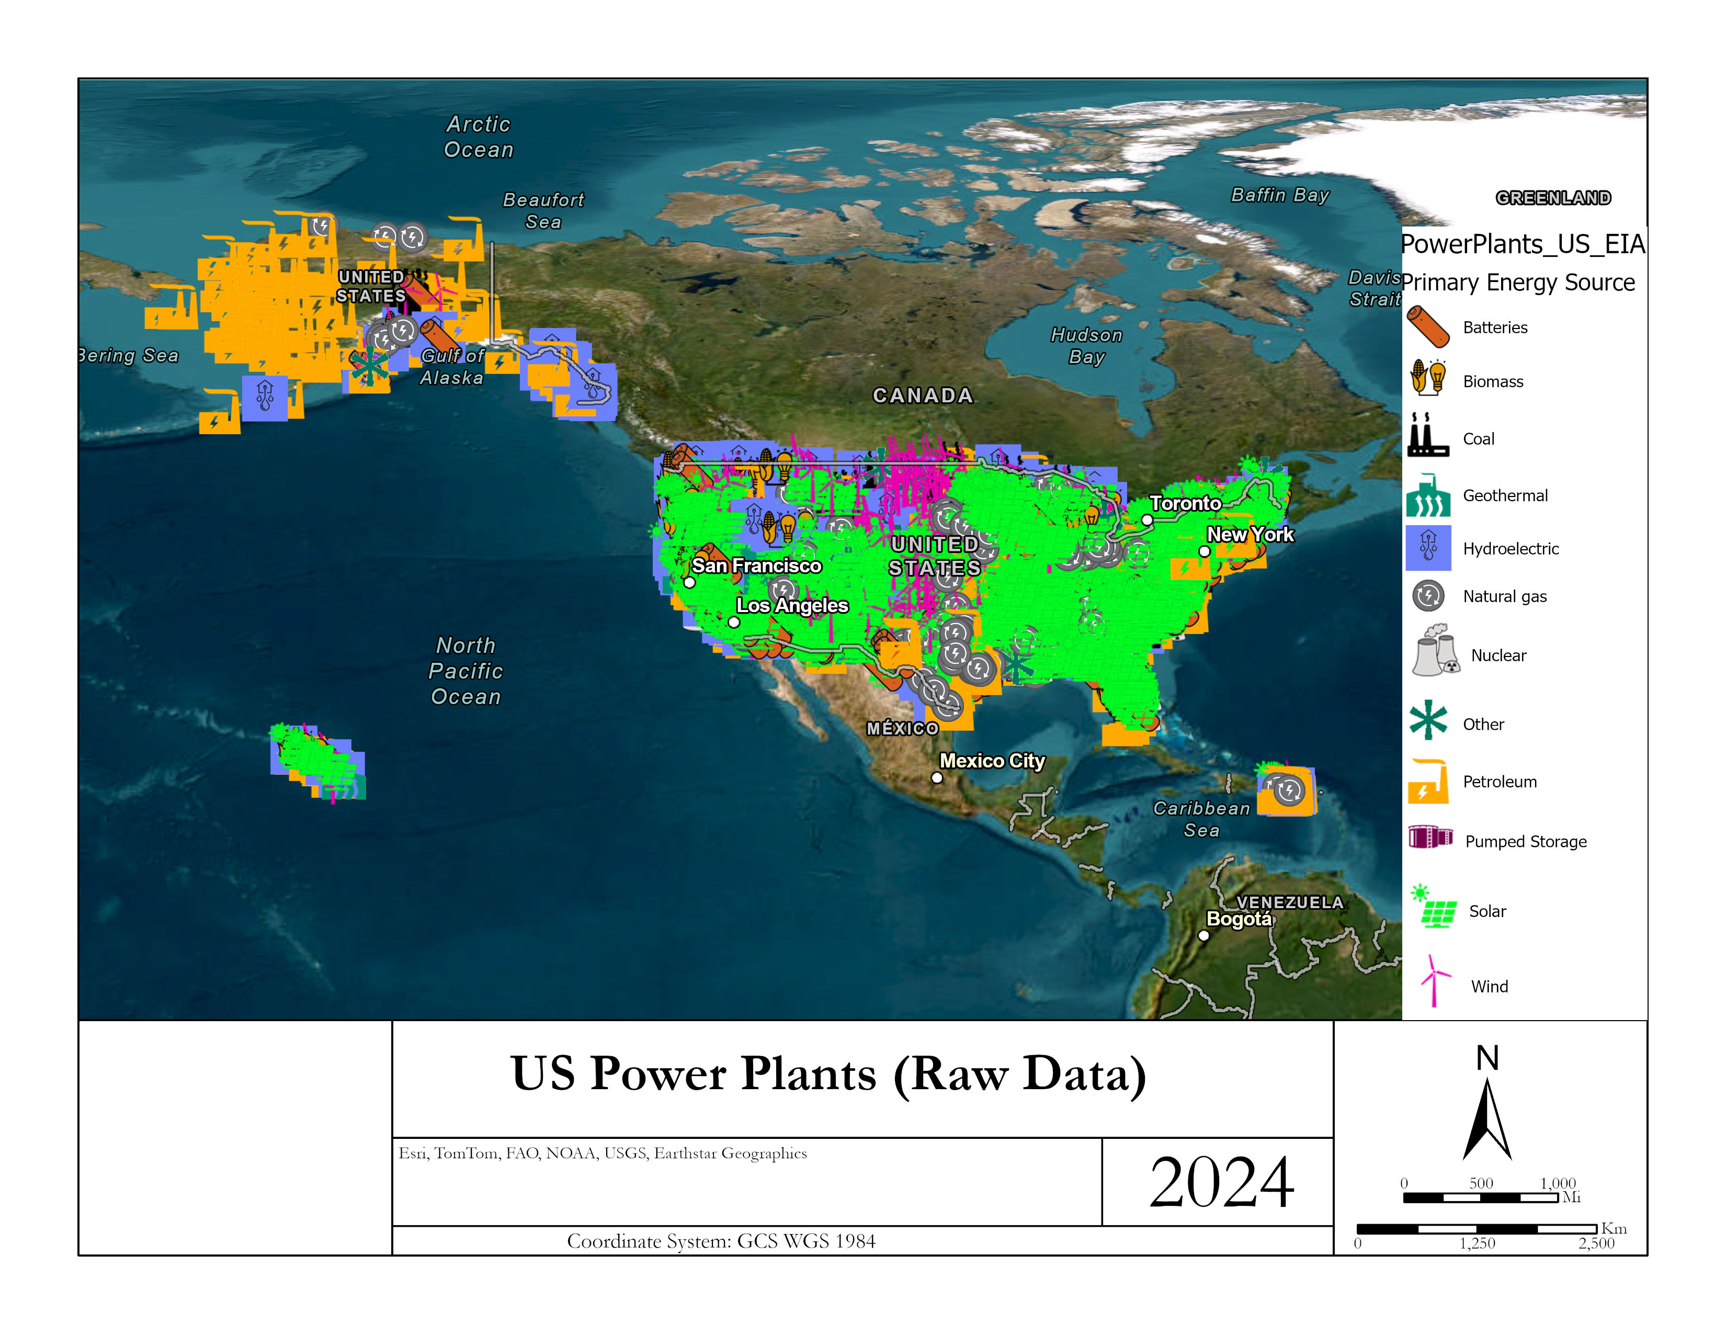
Data Set Visualization

Slide 3
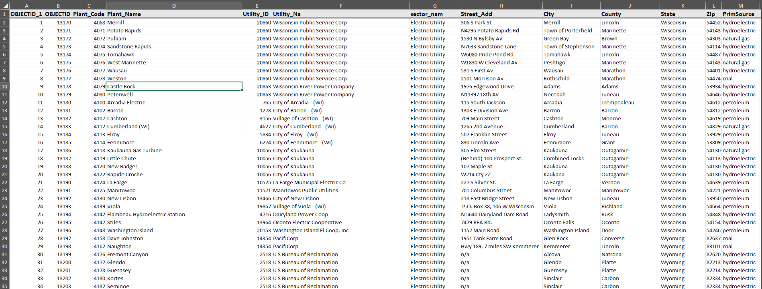
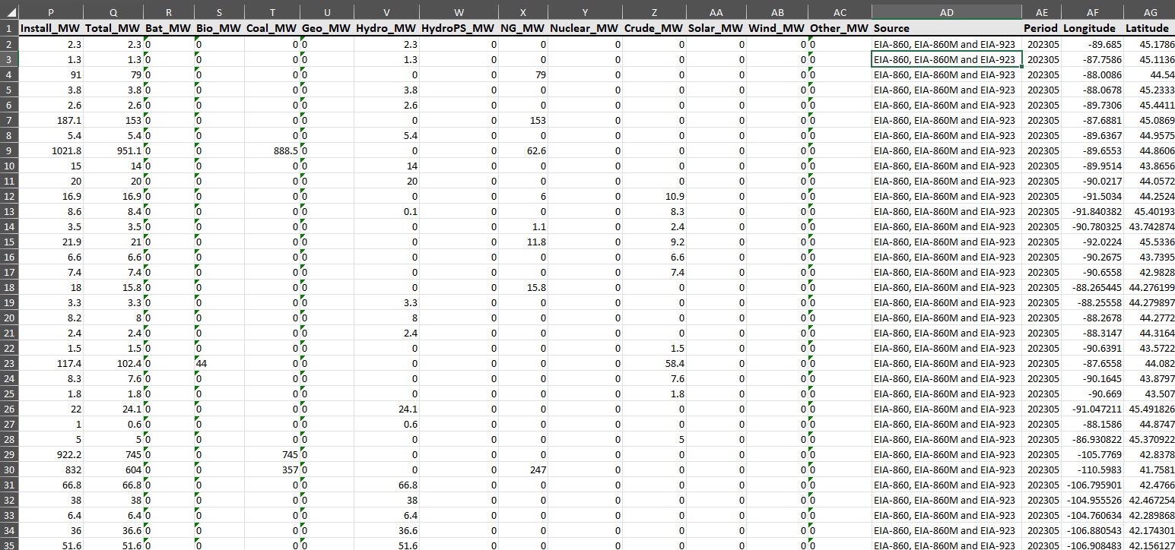
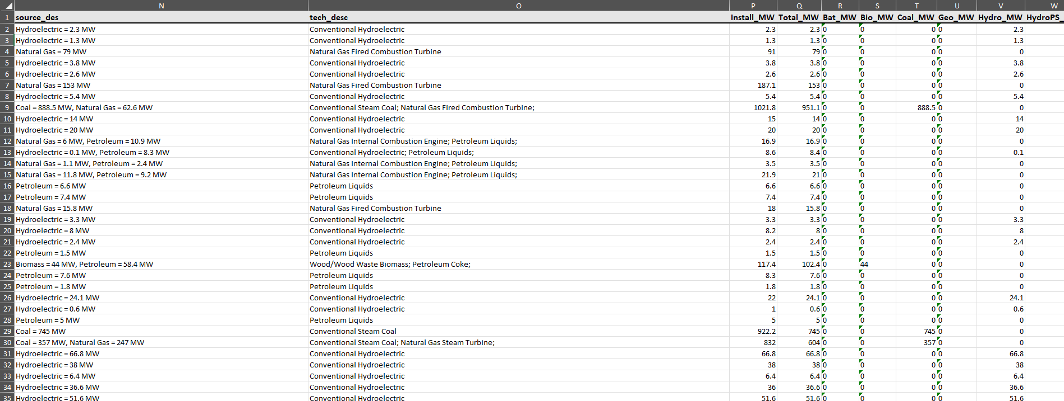
Data Set Description

Slide 4
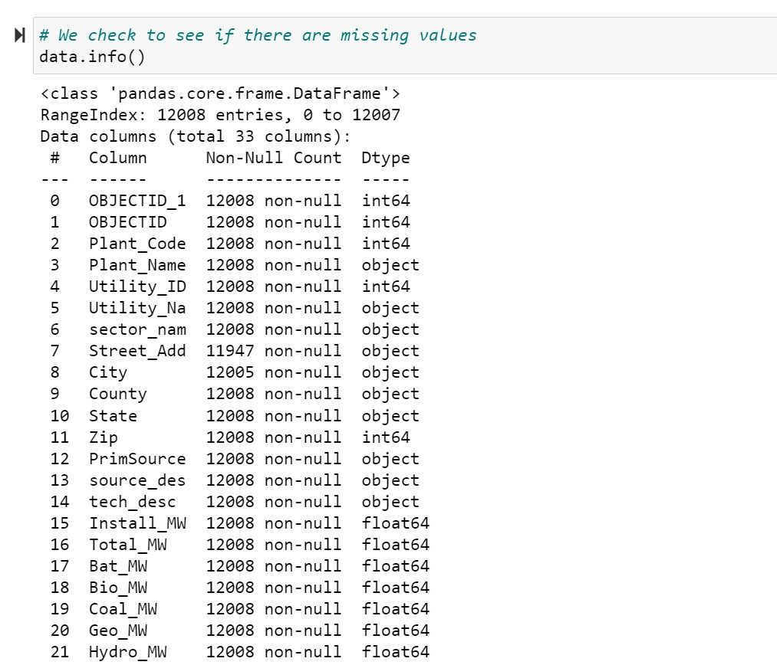
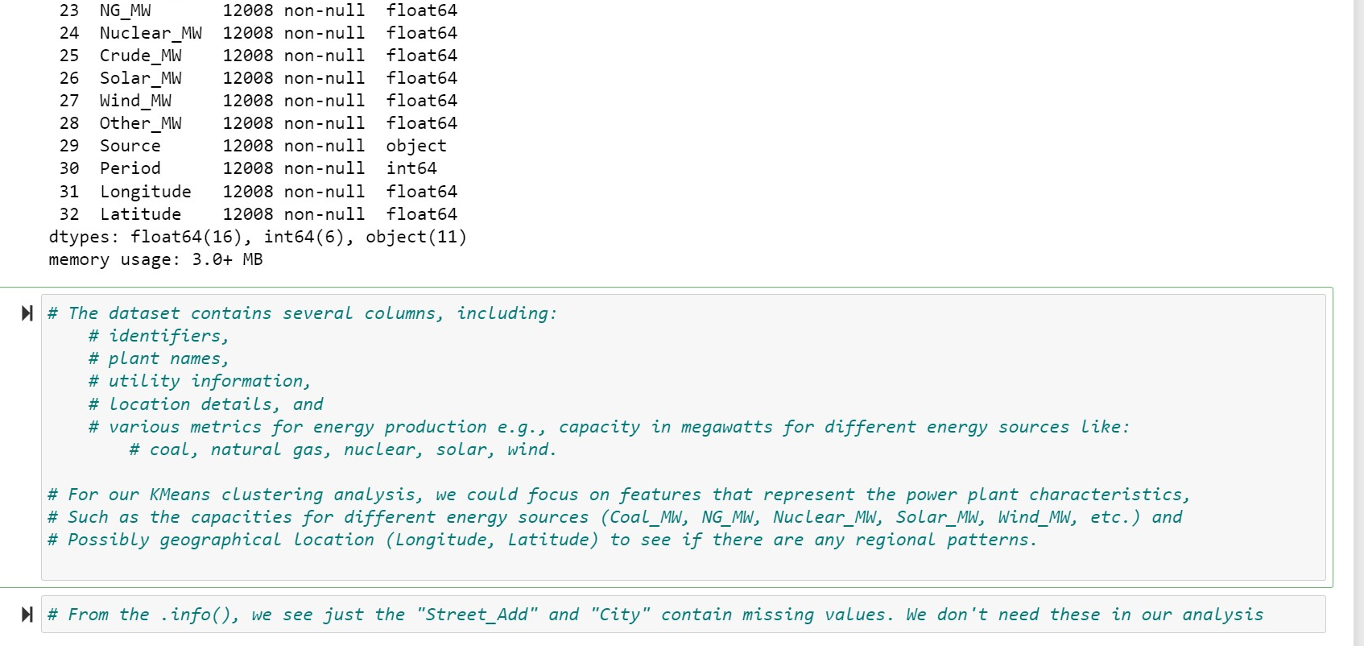
Data Set Description

Slide 5
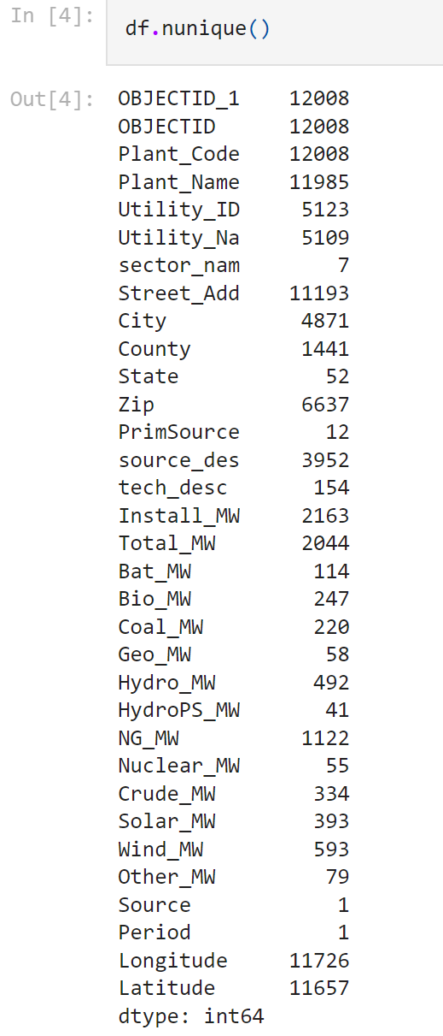
Data Statistics

Slide 6
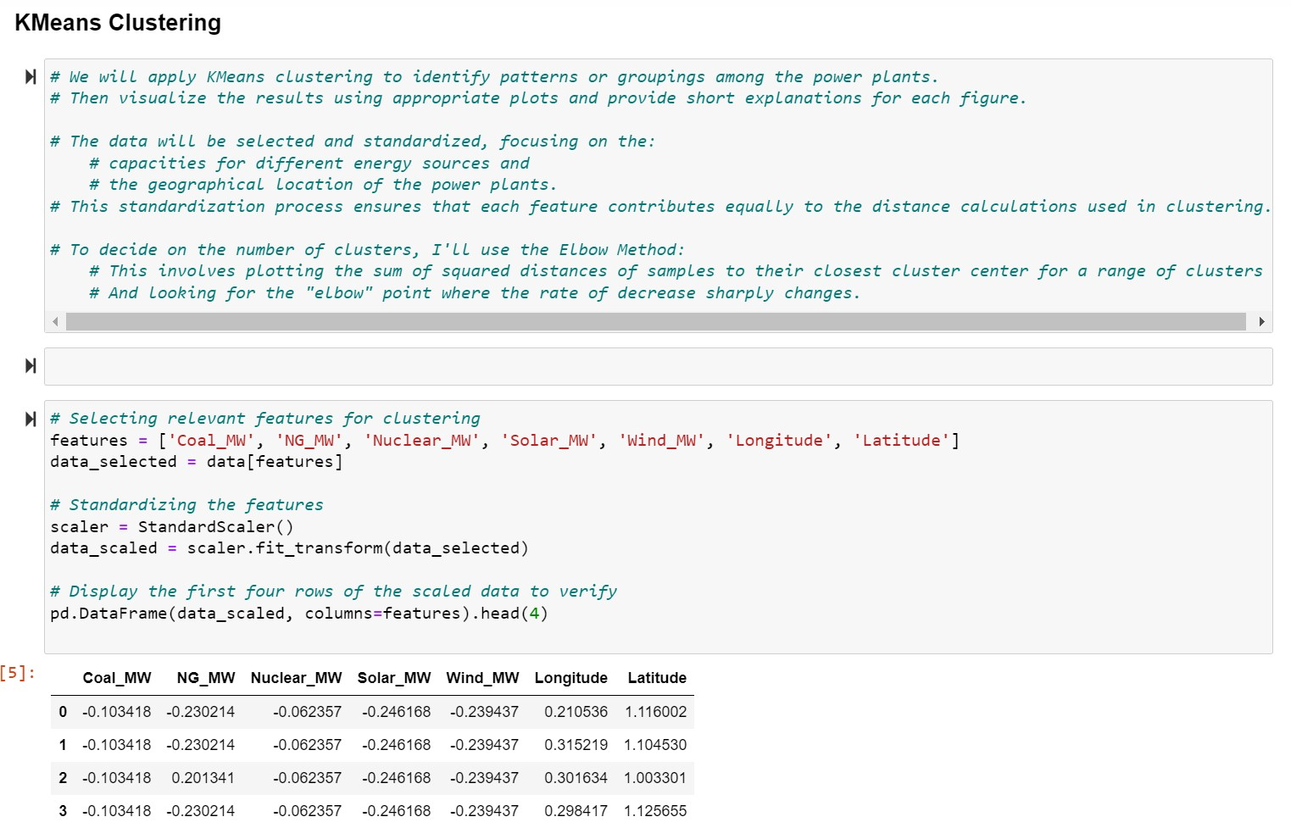
Preprocessing Techniques: Feature Selection & Standardization

Slide 7
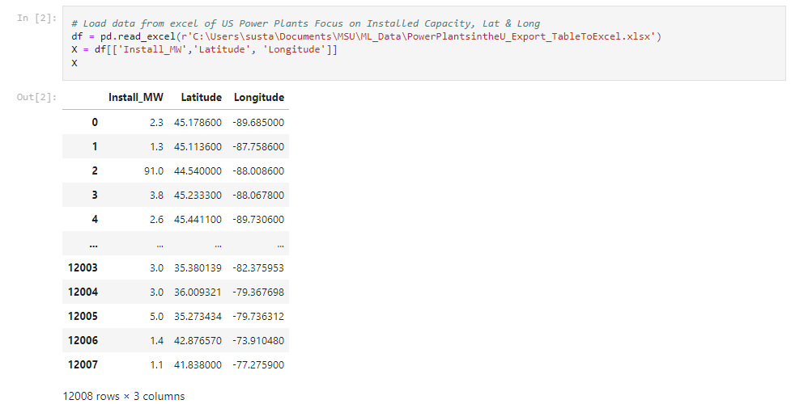
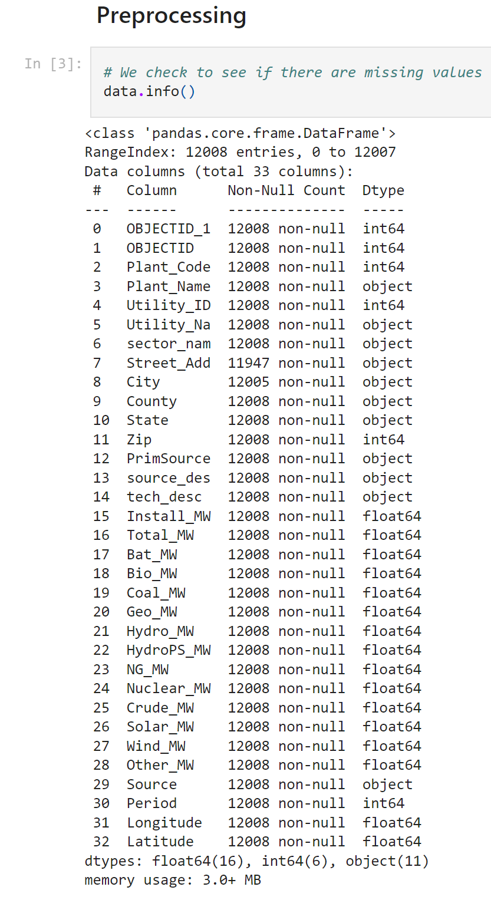
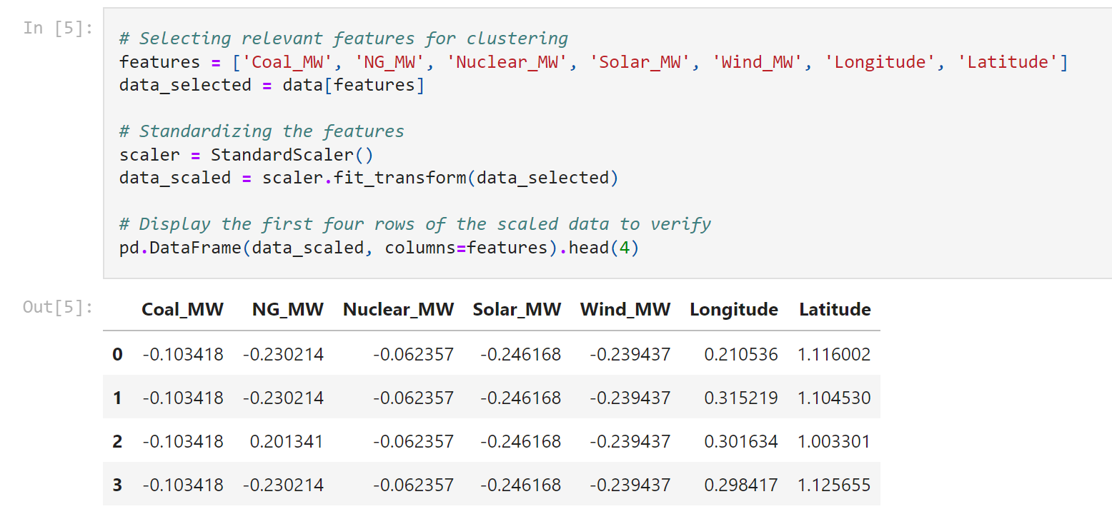
Preprocessing Techniques

Slide 8
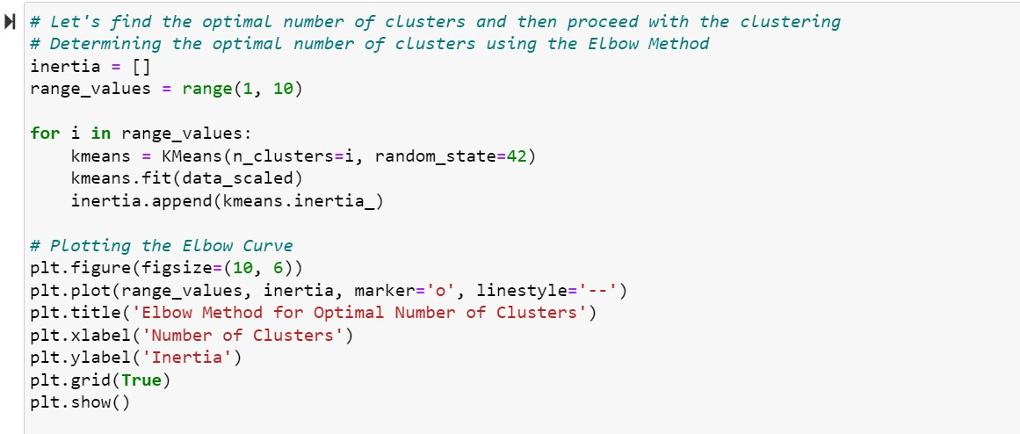
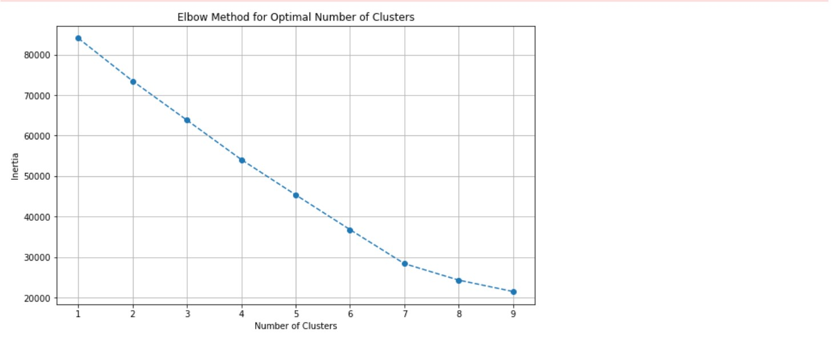
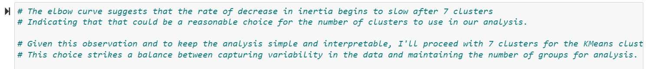
Machine Learning Technique: K-means Clustering

Slide 9
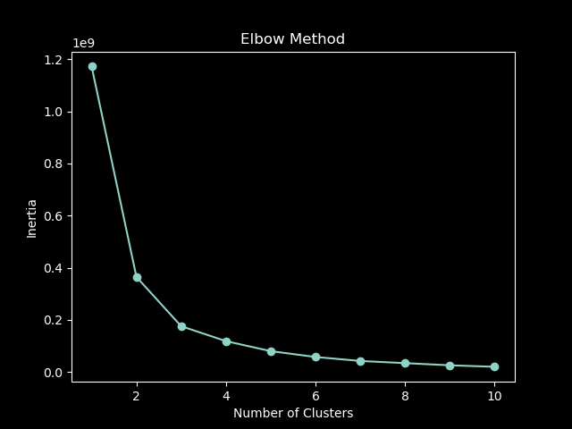
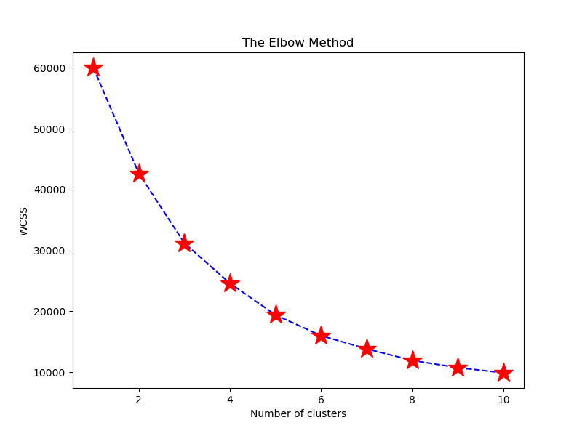
Machine Learning Technique: K-means Clustering (Elbow Method)

Slide 10
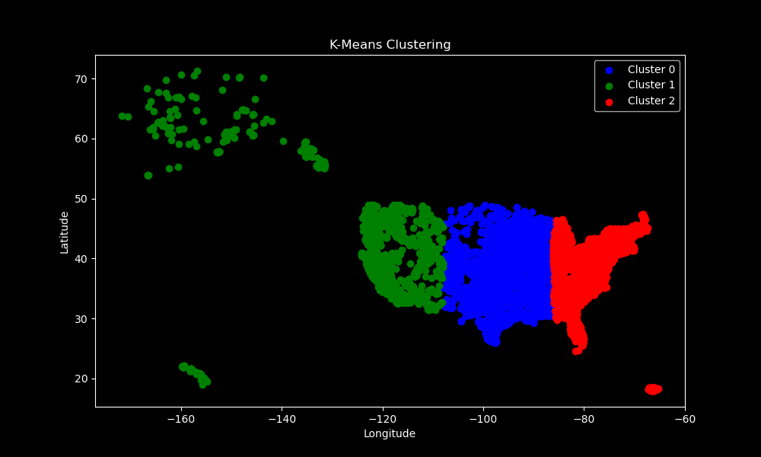
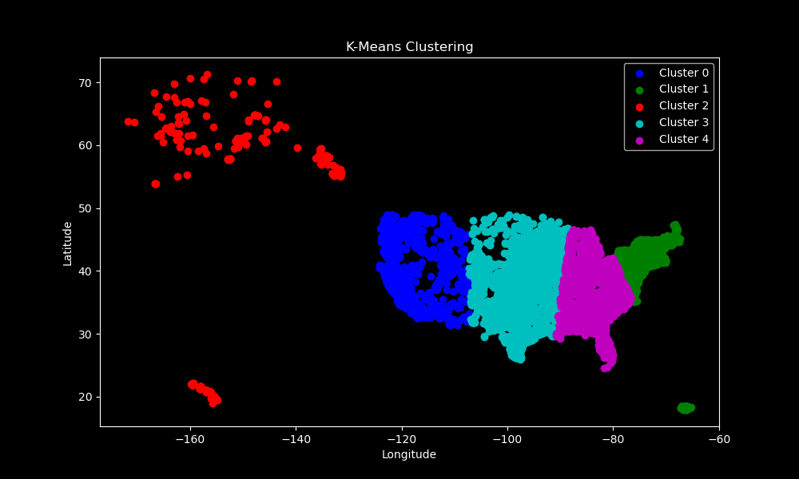
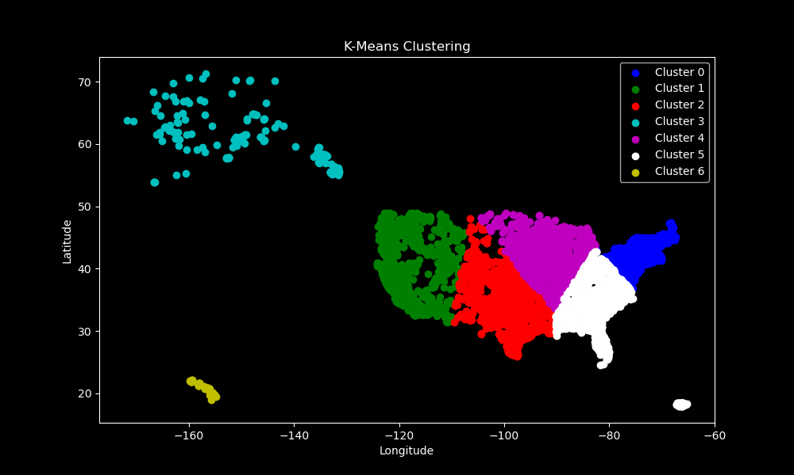
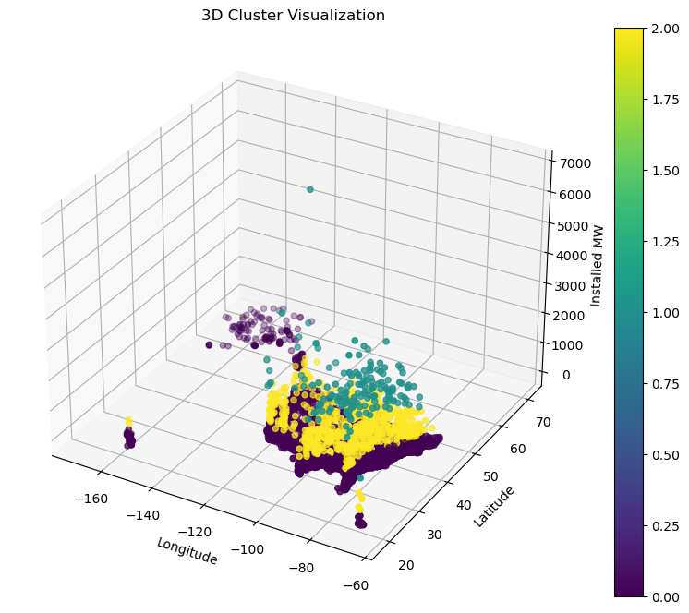
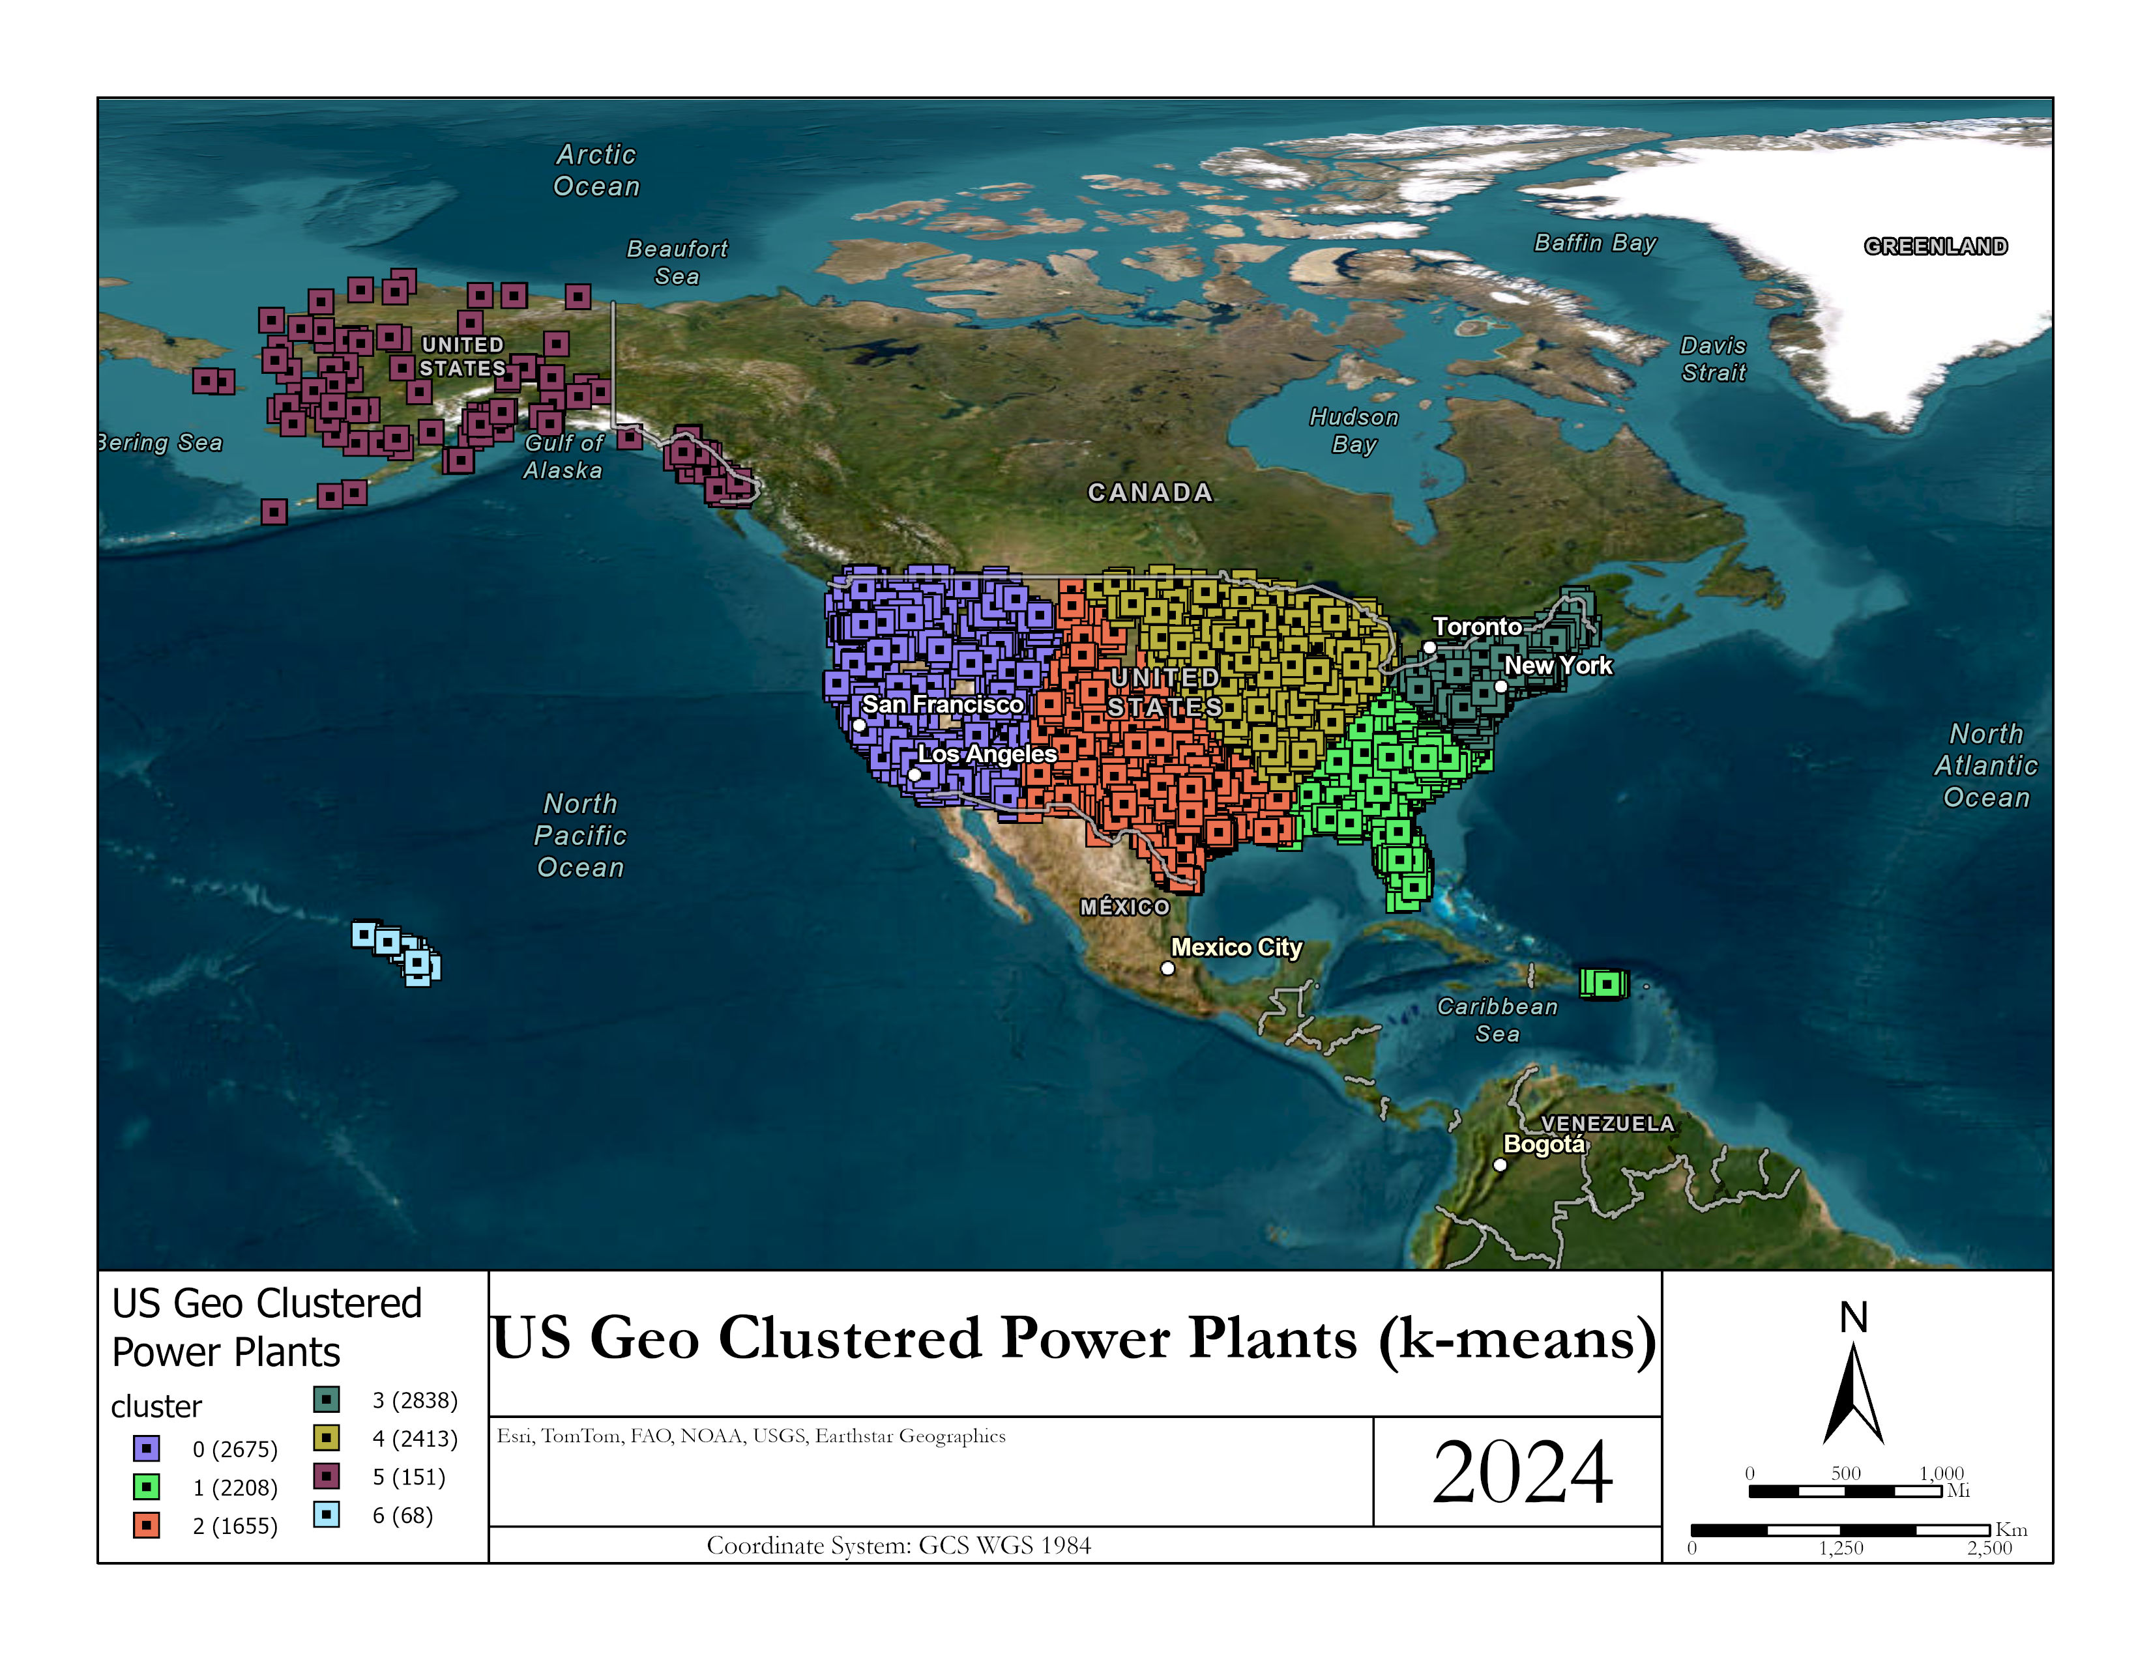
Python Results

Slide 11
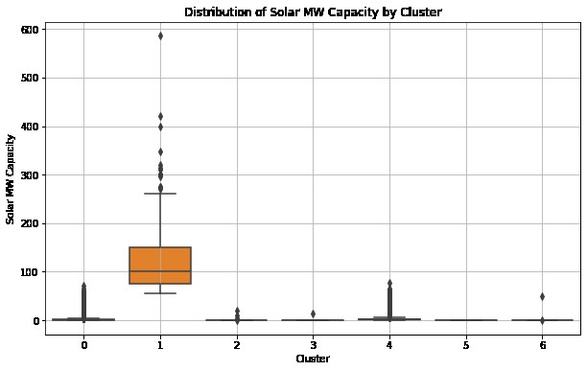
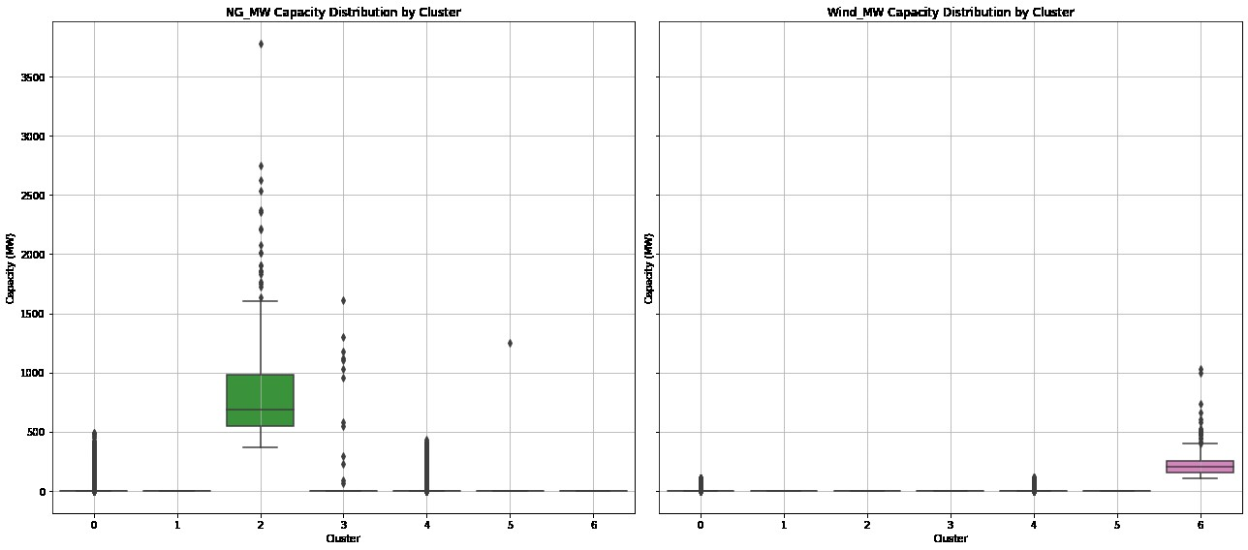
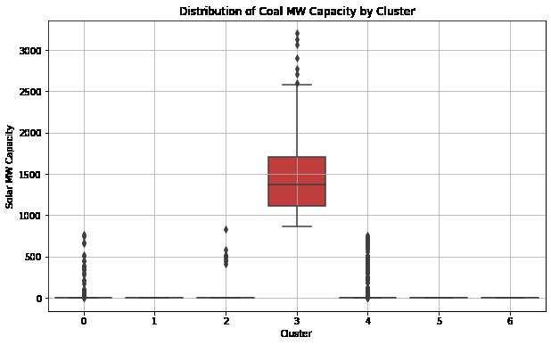
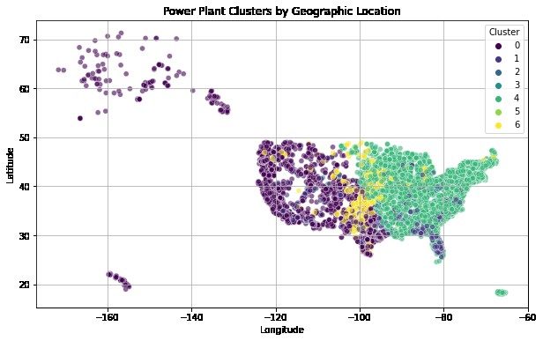
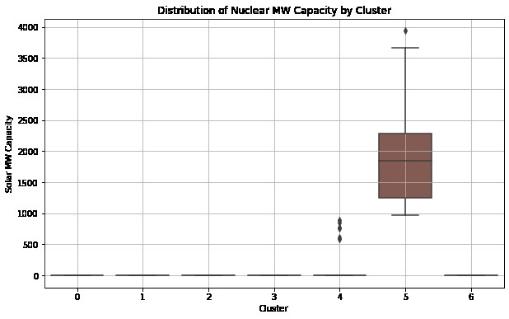
Python Results

Slide 12
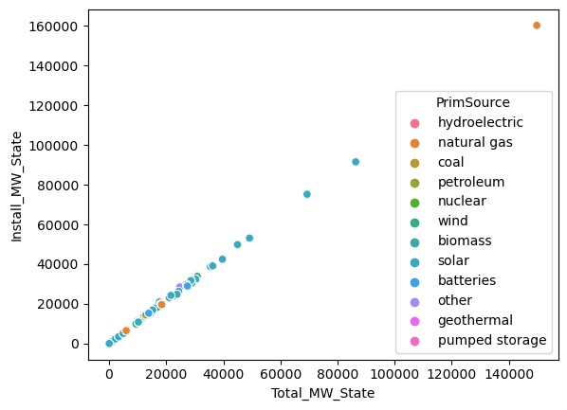
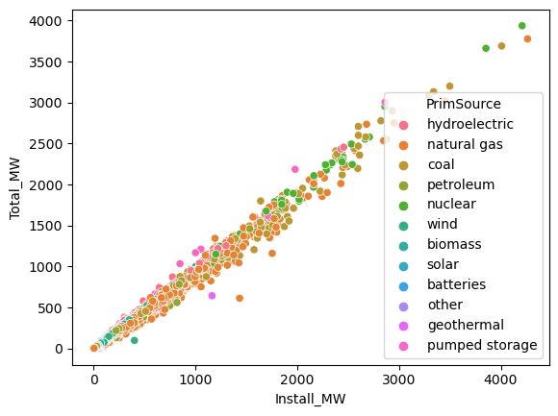
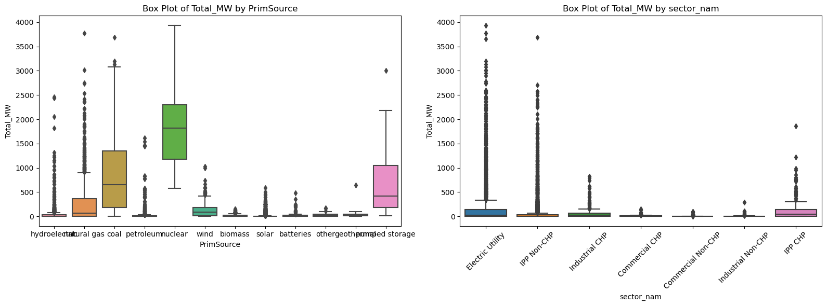
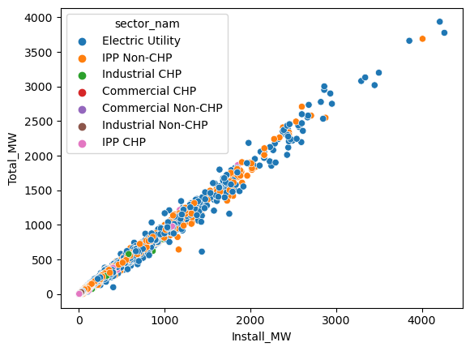
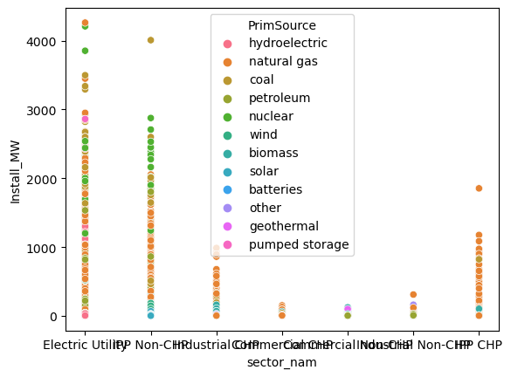
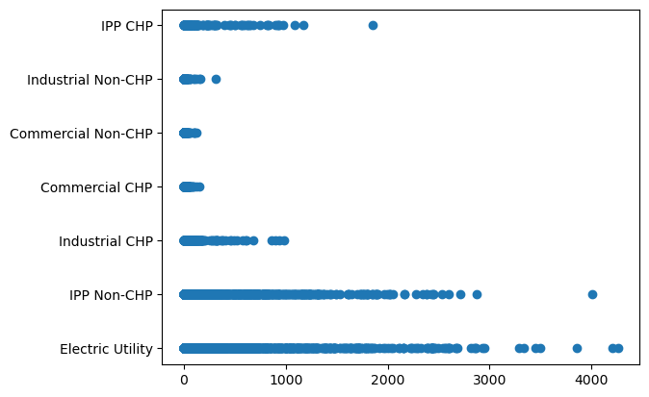
Python Results Pt 3

Slide 13
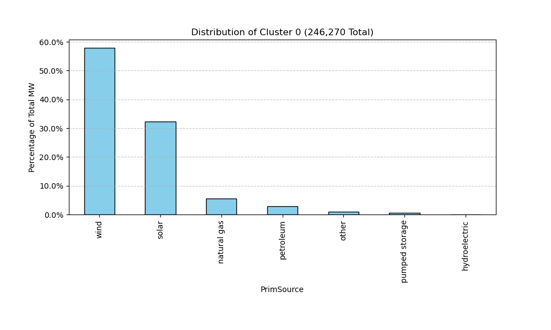
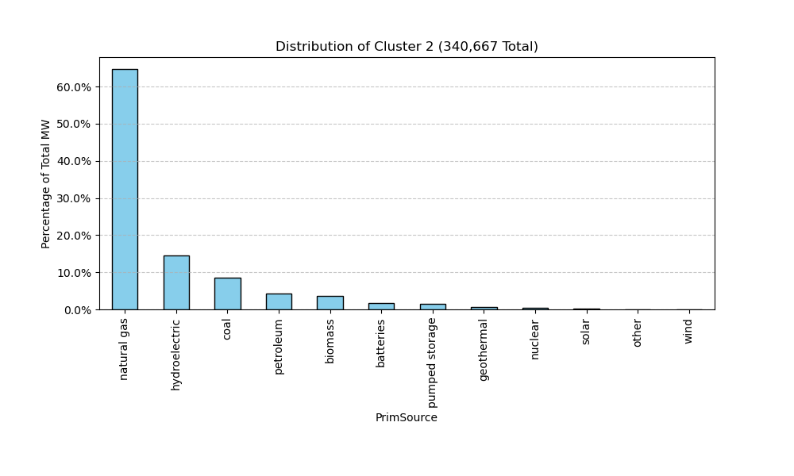
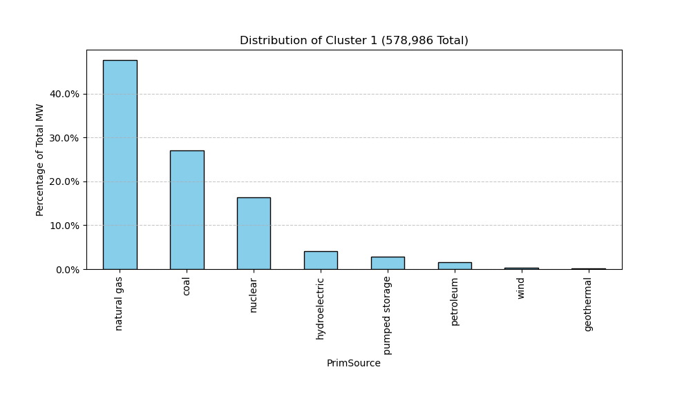
Python Results pt 4

Slide 14
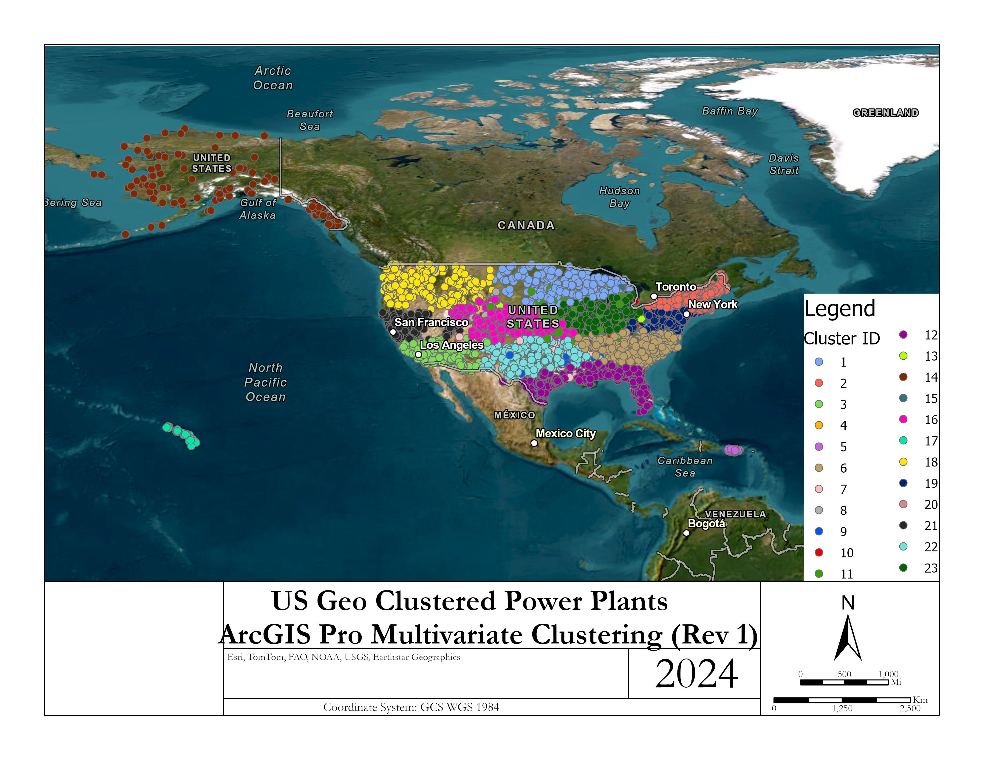
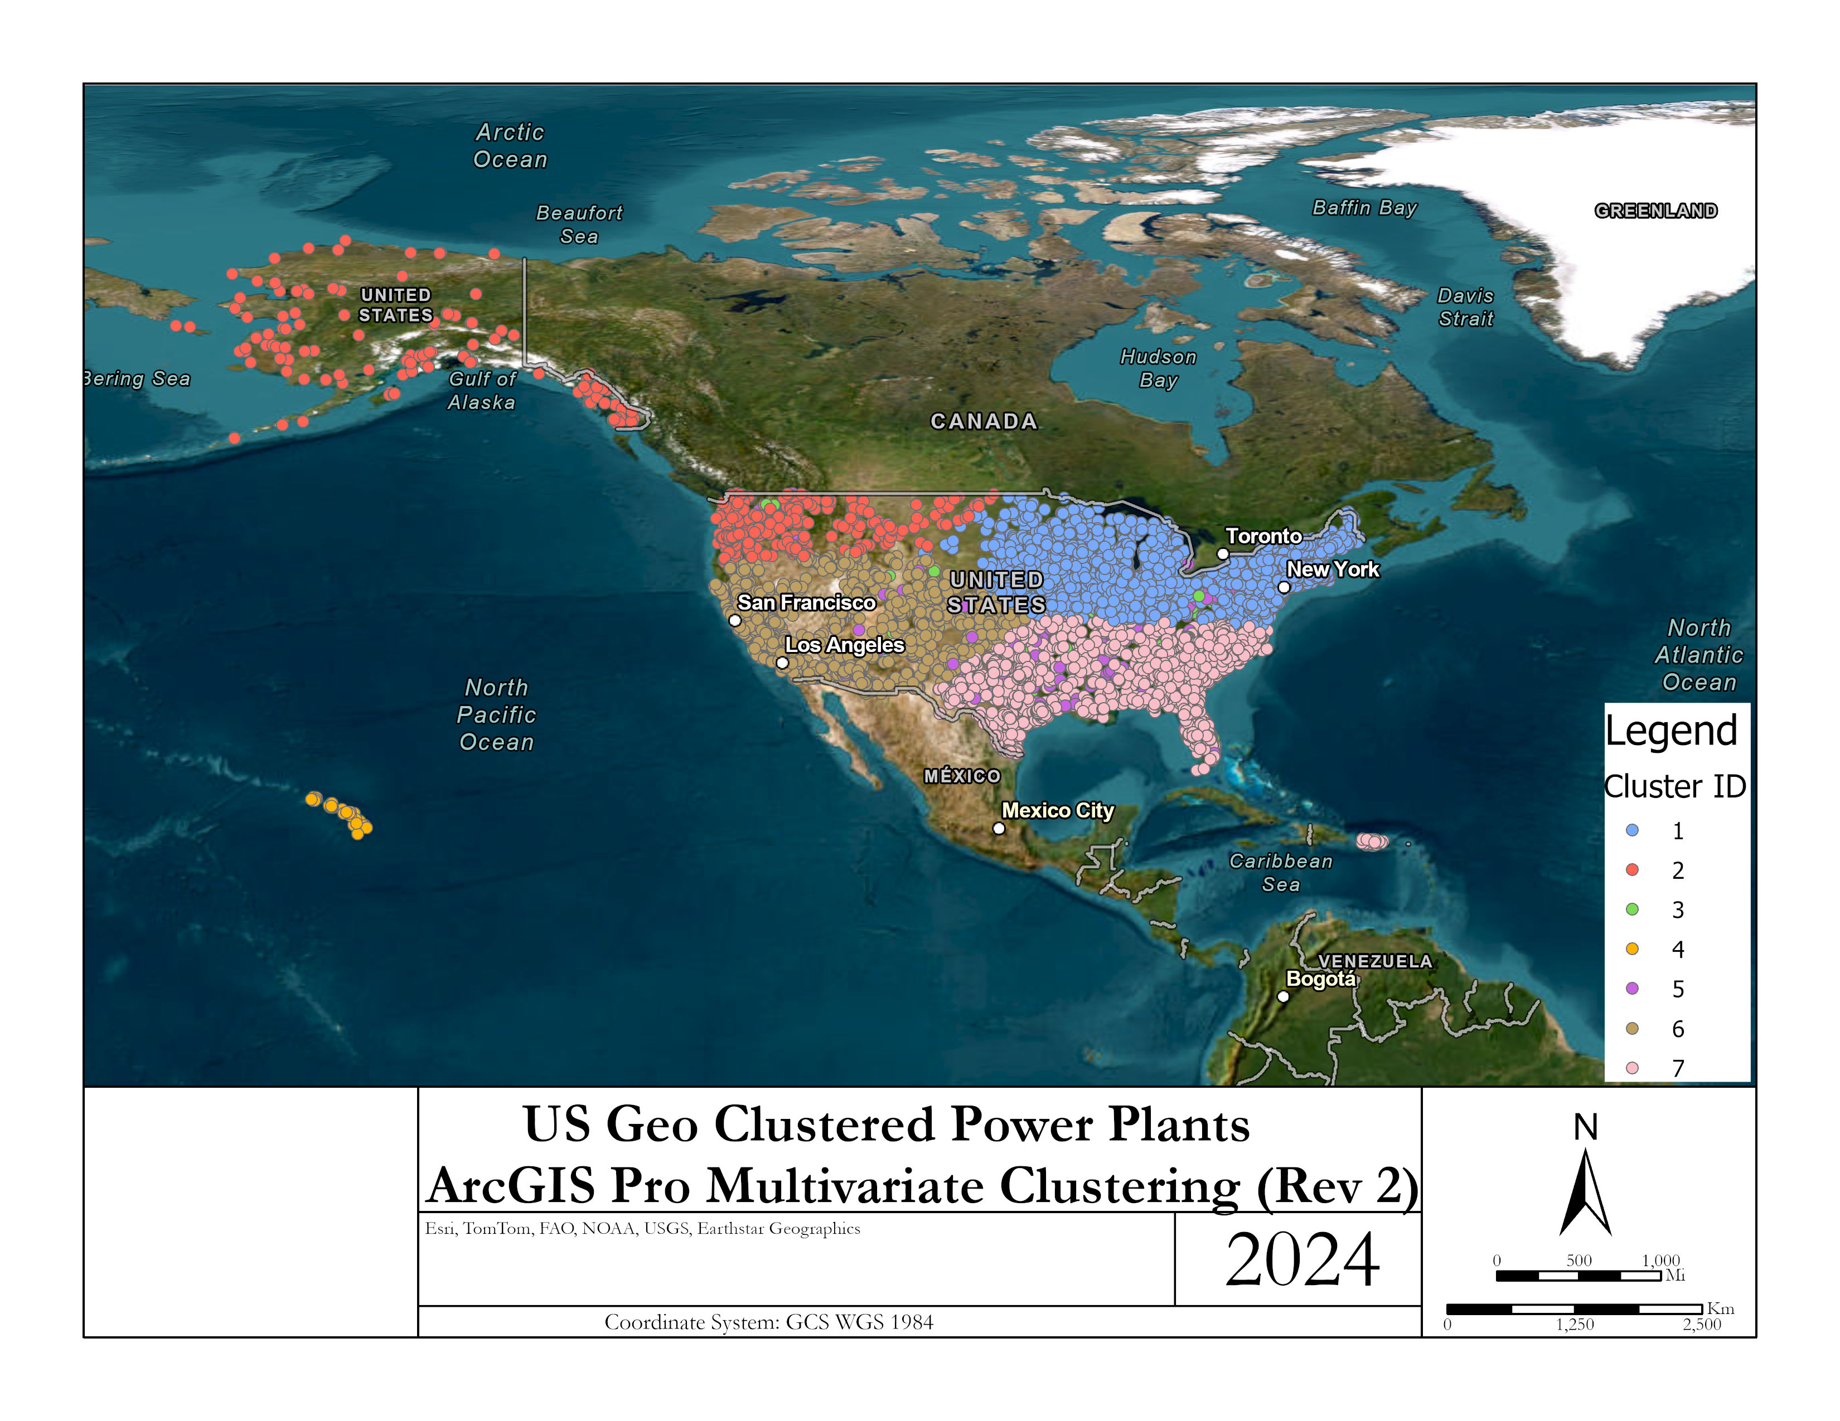
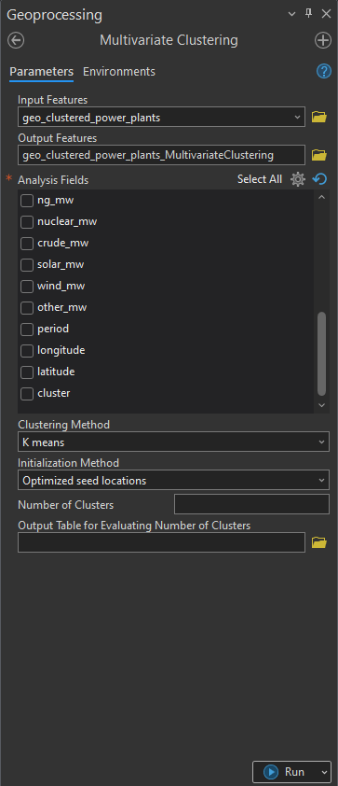
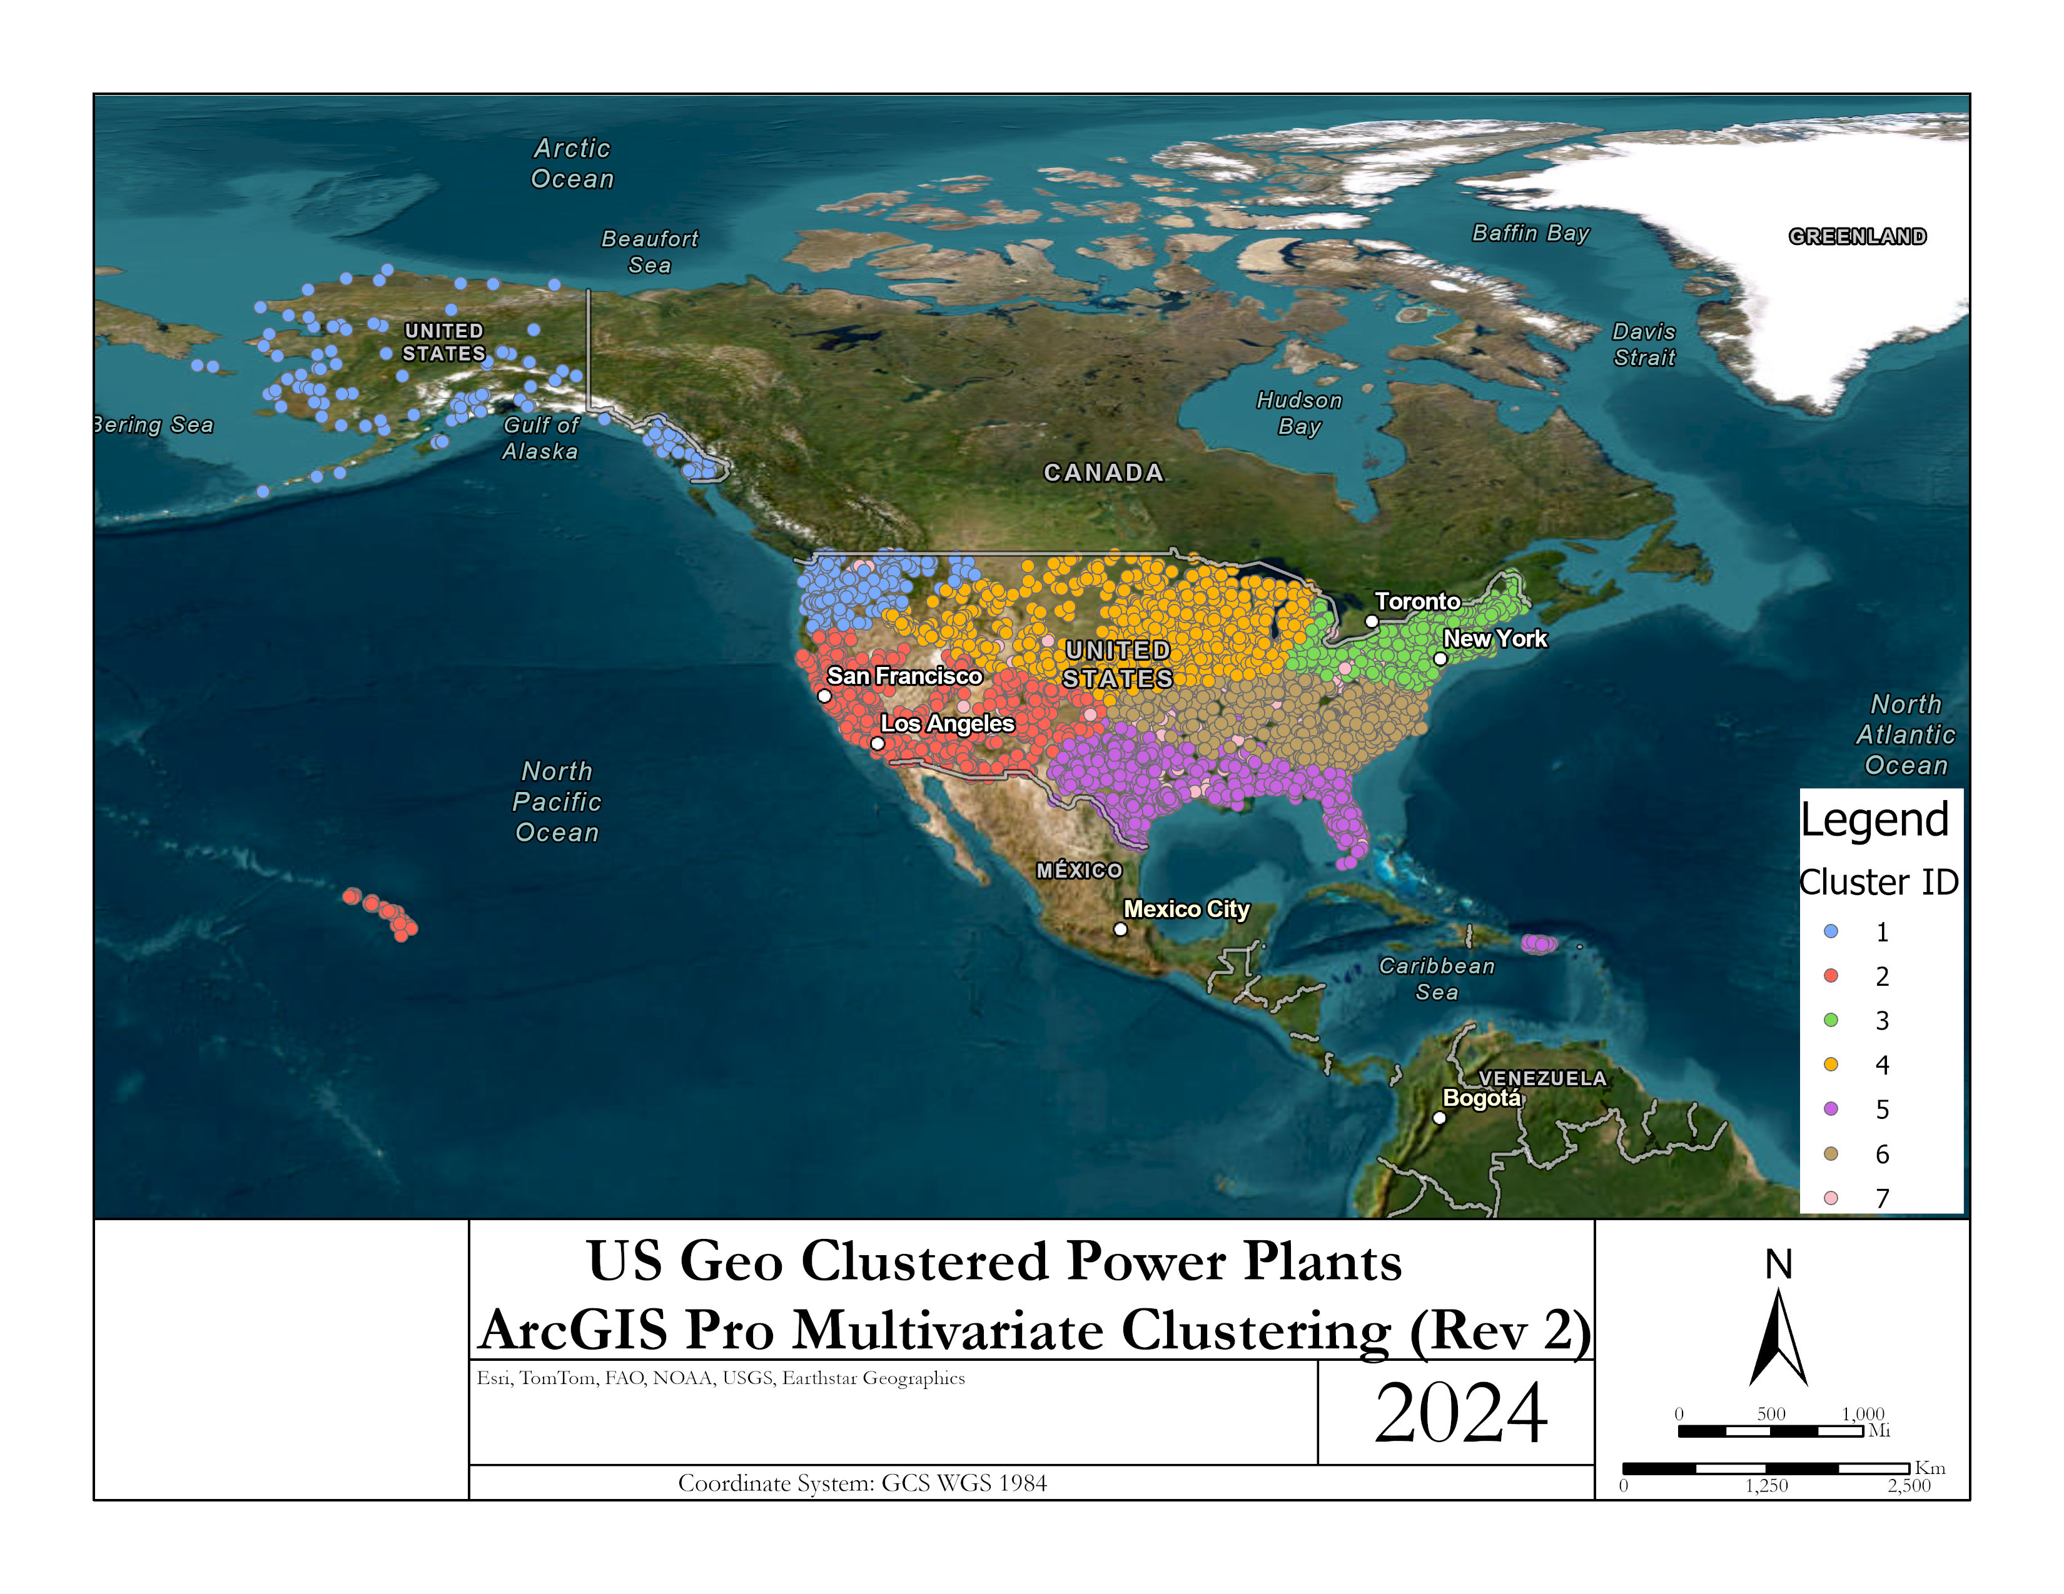
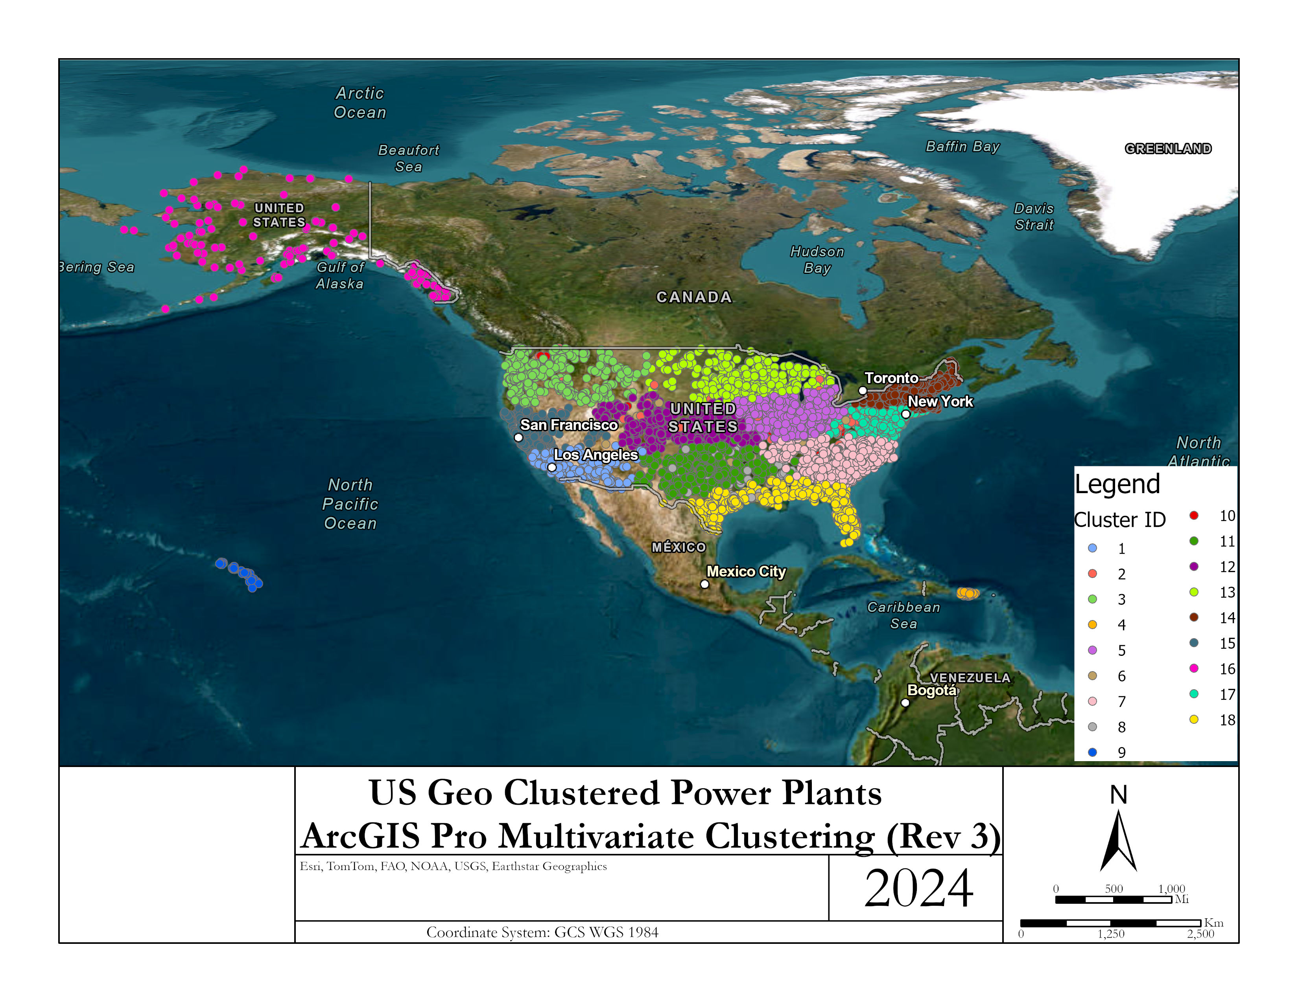
ArcGIS Results

Slide 15
Cluster Analysis Conclusion
We learned that different types of preprocessing can be utilized to perform a variety of further analysis especially depending on the type and variety of data that is collected.
Using power plants gives a wide range of initial attributes.
These visualizations provided insights into:
How power plants are geographically grouped based on the energy source capacities and location.
The variability in power capacity among different clusters.
Potentially indicating specialization or focus on a particular energy source in certain regions or by certain types of power plants.
We learned that different techniques of preprocessing and selecting different features can perform different varieties of analyses, to yield different insights, especially depending on the type and variety of data that is collected.
Using power plants gives a wide range of initial attributes.
Once K values are determined even if using the optimum value (i.e. 3) doesn’t translate to accurate clusters. So we played around with different values until we got a proper fit. The best fit from my perspective came with the value of k=7.
ArcGIS Pro has a tool called Multivariate Clustering that we were able to use and compare to our python results and performs other combination of attributes to see how ArcGIS would perform its own clustering.

Slide 16
References
https://montclair.maps.arcgis.com/home/item.html?id=b063316fac7345dba4bae96eaa813b2f (US Power Plants Data source)
https://pro.arcgis.com/en/pro-app/latest/tool-reference/spatial-statistics/multivariate-clustering.htm (ArcGIS - Multivariate Clustering Tool)

